Slide 1
Sparse-Dense Side-Tuner for efficient Video Temporal Grounding
Presenter: Kim Seung Hwan (seunghwan.kim@snu.ac.kr)

Slide 2
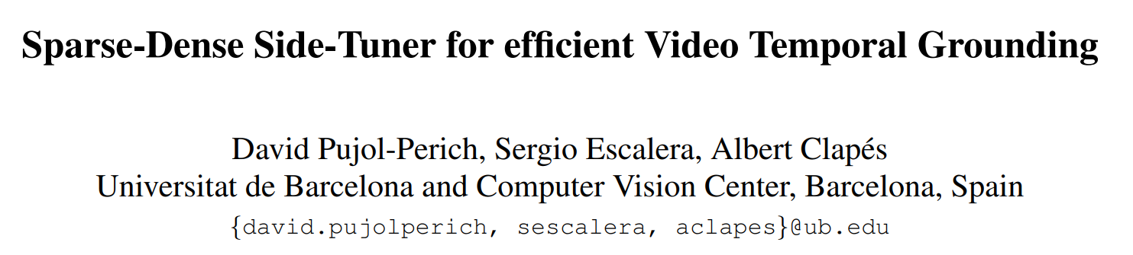
Paper
ICCV ’25
The details are very sophisticated, but the main concept is simple

Slide 3
Problem Setting
VTG is the combined task
It involves Moment Retrieval (MR), Highlight Detection (HD)

Slide 4
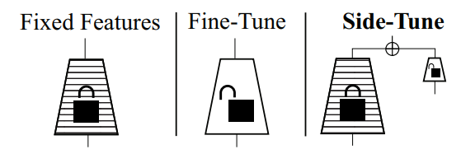
Problem Setting
The task is quite difficult, so people often utilize strong backbones
But full fine-tuning a powerful backbone (CLIP, LLM, etc.) is impractical!
We need MEFT (Side-tuning) beyond PEFT (Prompting, LORA, etc.) to avoid full backpropagation

Slide 5
Contributions
Propose first anchor-free ST architecture for multitask VTG
Proposed method surpasses SOTA while reducing p.c. by up to 73%
Overall improvement of DETR-based VTG model
Propose a method to extract intermediate features of the video backbone for side-tuning

Slide 6
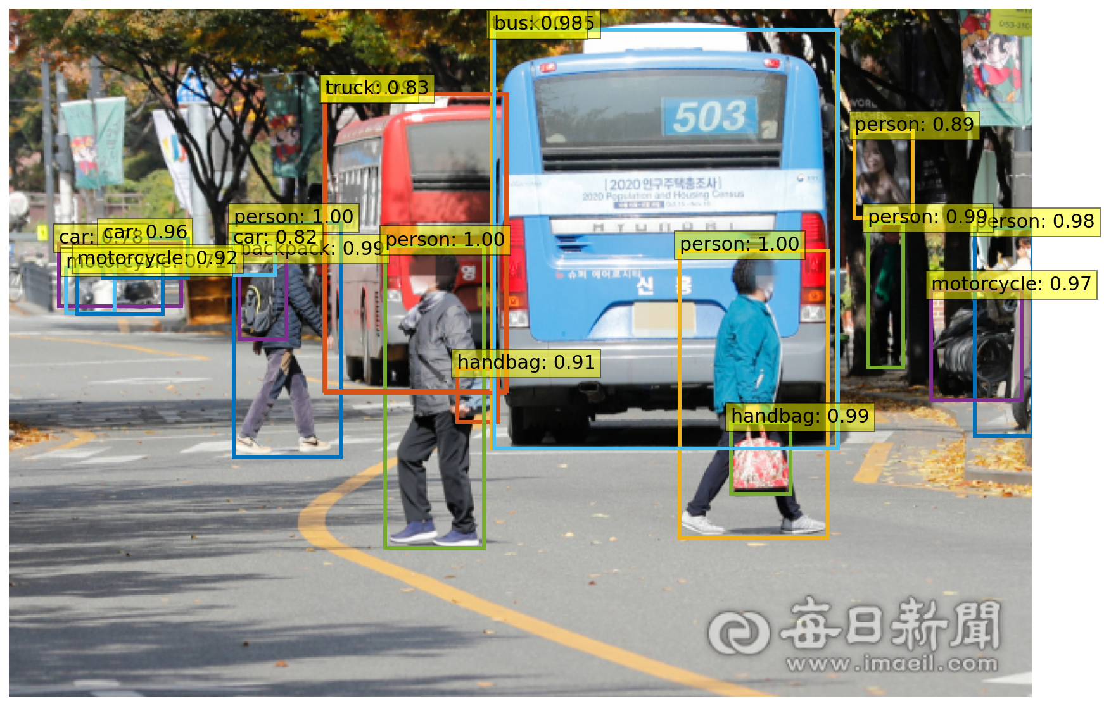
DETR? Anchor-free?

Slide 7

Definition
Input-query pair $(X^{v},X^{t})$ where $X^{v}∈ℝ^{T×H×W×3}$ and $X^{t}∈ℝ^{L×F_{e}}$
Frame-wise saliency score $Y^{s}∈ℝ^{T}$ for HD
$M$ action moments $Y^{m}∈ℝ^{M×2}$ for MR

Slide 8
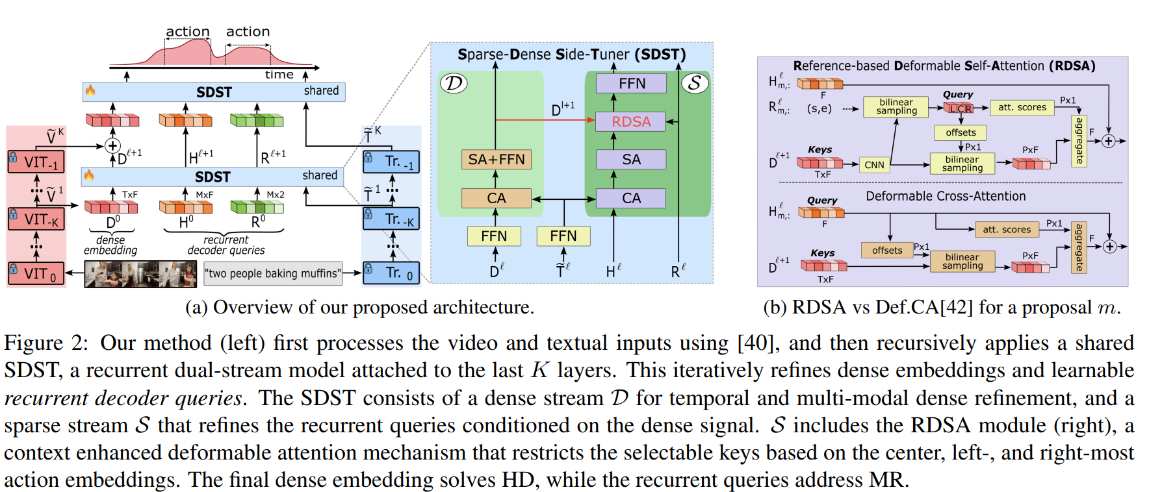
Method

Slide 9
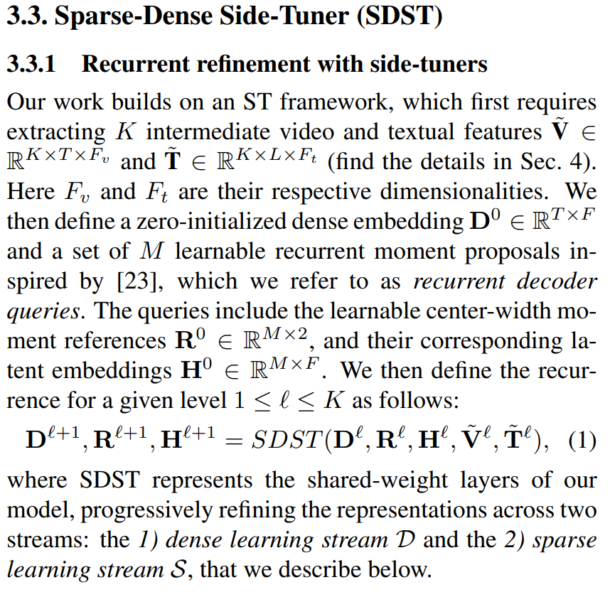
Method

Slide 10
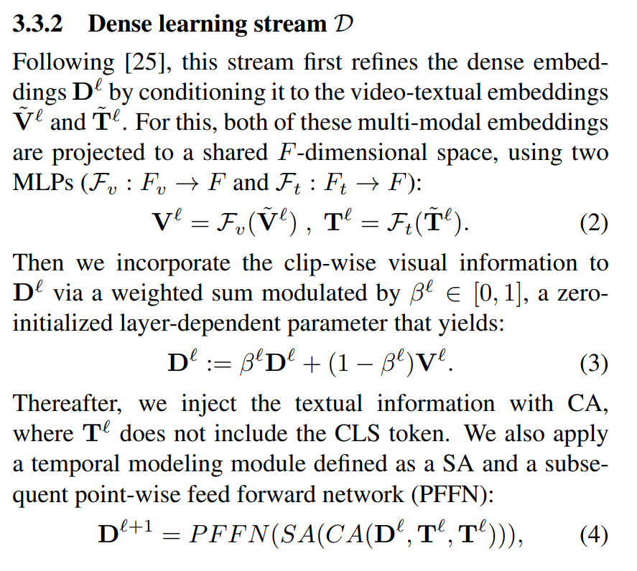
Method

Slide 11
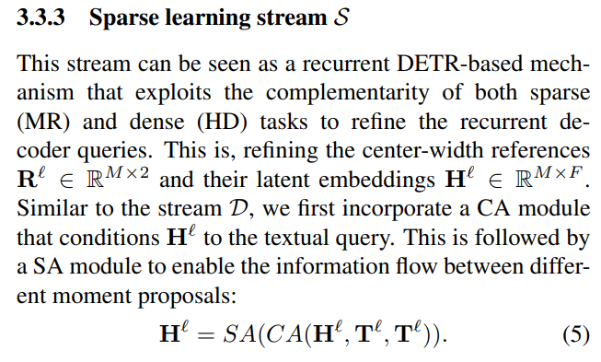
Method

Slide 12
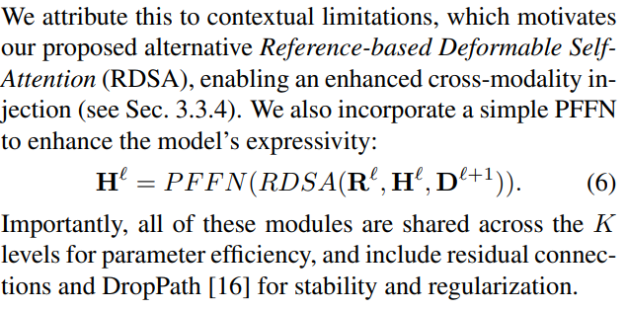
Method

Slide 13
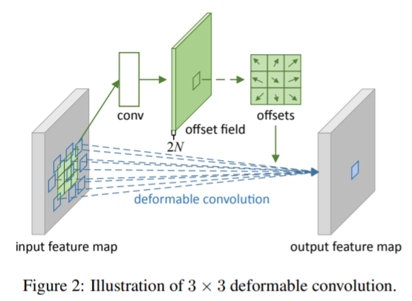
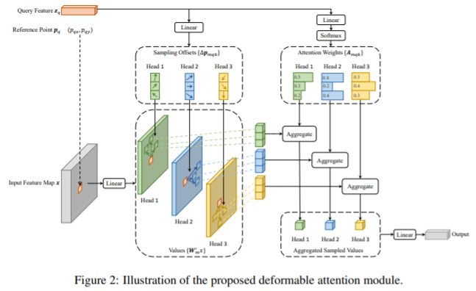
Deformable Attention

Slide 14

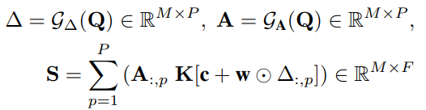
Deformable Attention
This works very well for self-attention
This is also used for cross-attention in existing works,
But it is incorrect!

Slide 15
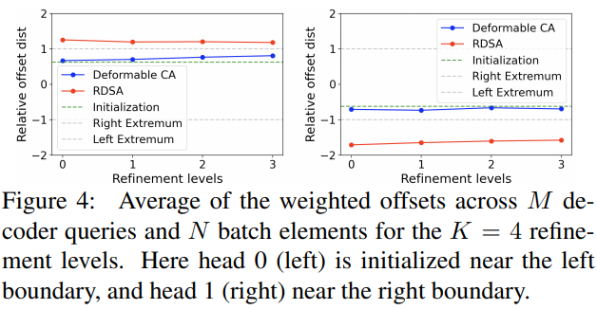
Deformable Attention
The offset collapse near the initialization values
Inability to select keys beyond the estimated boundary

Slide 16
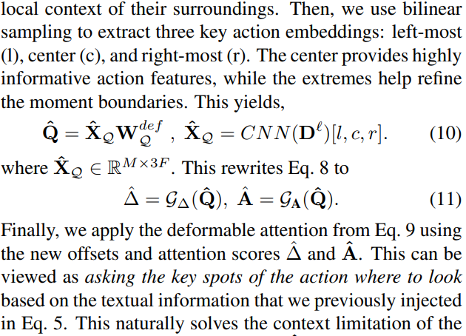
Method

Slide 17
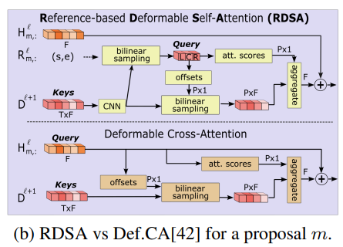
Method

Slide 18
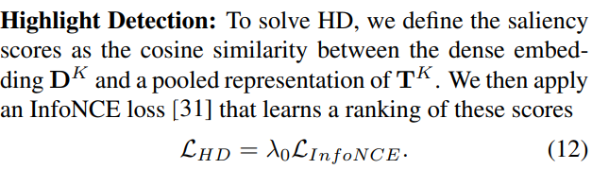

Objectives
Pass $K$ intermediate features into shared weight SDST
Use a huge number of objectives function

Slide 19
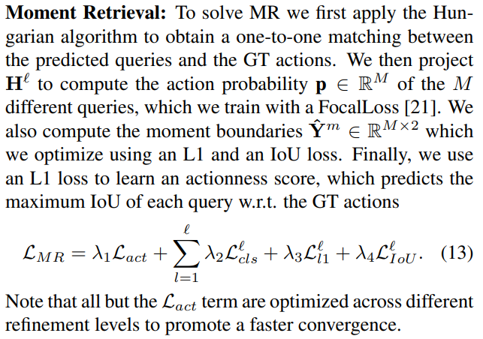
Objectives
Pass $K$ intermediate features into shared weight SDST
Use a huge number of objectives function

Slide 20
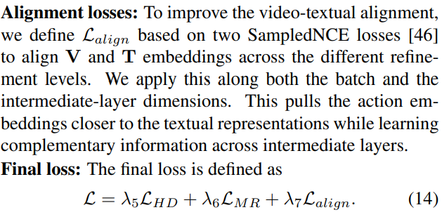
Objectives
Pass $K$ intermediate features into shared weight SDST
Use a huge number of objectives function

Slide 21

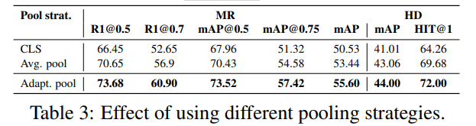
Extracting Intermediate Features
Unlike just taking the last tokens, using intermediate features, which has a lot of information
Pooling is needed to reduce the dimensionality
Adaptive pooling is great, but it is too expensive to train on each layer

Slide 22
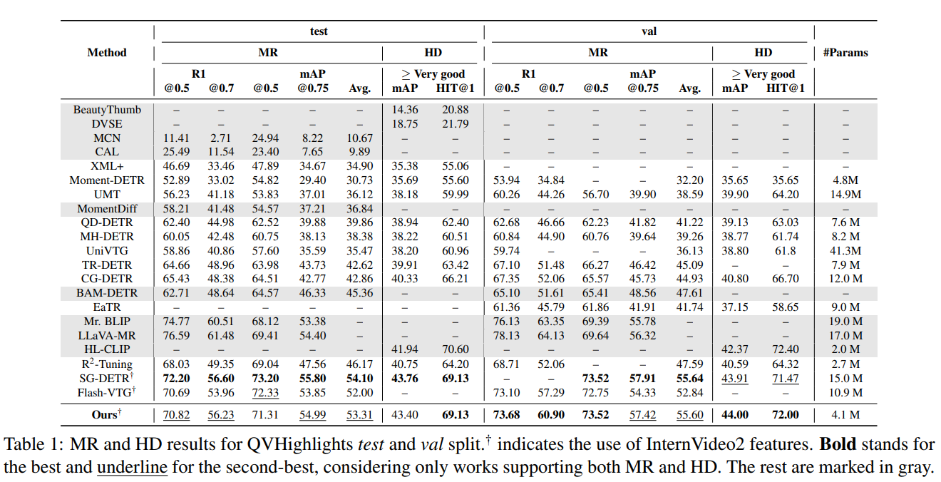
Results

Slide 23
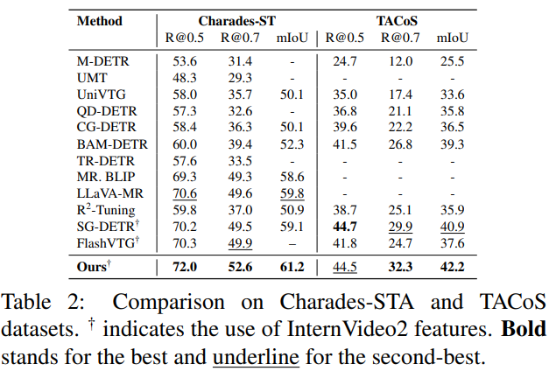
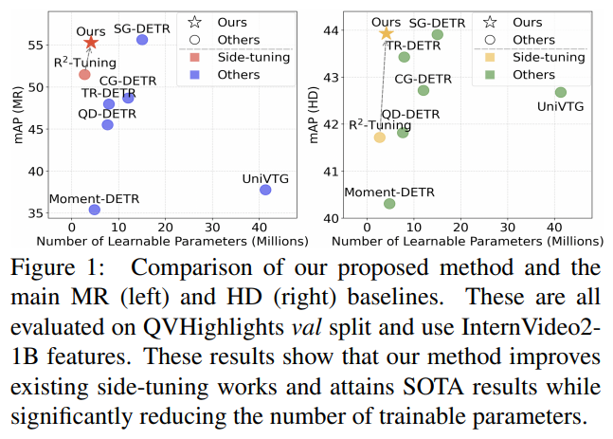
Results

Slide 24
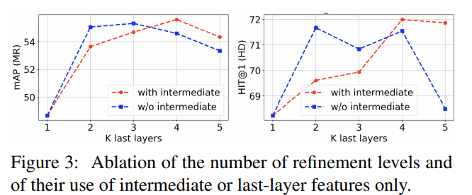
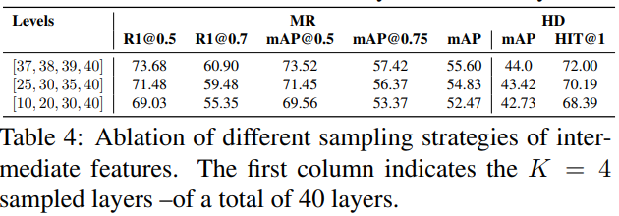
Ablations

Slide 25
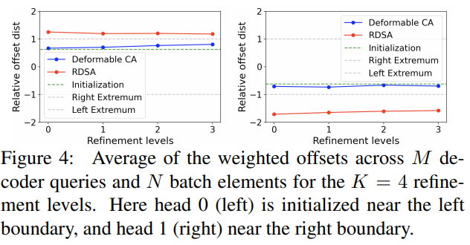
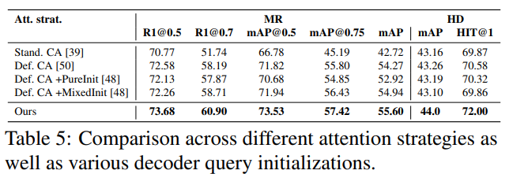
Ablations

Slide 26
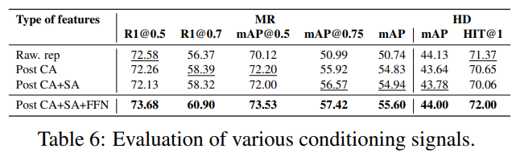
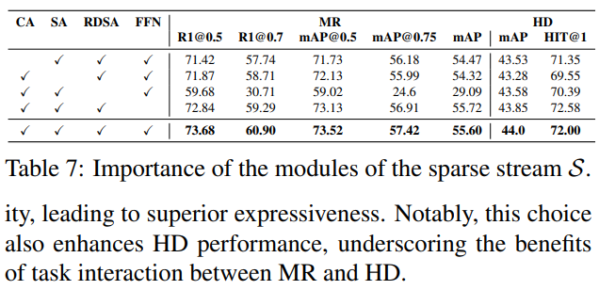
Ablations

Slide 27
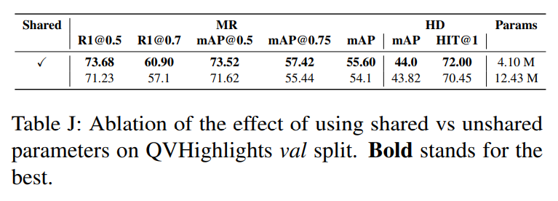
Appendix
They use only one RTX 6000 (48GB vram)
Full FT like LoRA or Adapter does not even work on the GPU
Shared weight is better

Slide 28
Takeaway
A sophisticated approach to VTG
How can we minimize learning, in particular, without backpropagation though LLM?
Frozen adaptive sampling is clearly suboptimal, but it is efficient, making it a plausible approach
The backbone is just used as a black box, and the main contribution of the paper lies in microarchitecture tuning

Slide 29
Thank you for listening
Presenter: Kim Seung Hwan (seunghwan.kim@snu.ac.kr)

